Slide 1
Category review: Chips
June 2020
Retail Analytics
Brand note: If client logo is not required, use alternate title page layout right click slide thumbnail > Layout > Title

Slide 2
Notes:
To view Privacy video explaining how important data privacy is to Quantium, please click here: https://www.youtube.com/watch?v=Zq1QDAkoRzU
or here Q:\Company Reference\Brand & Design\Brand videos\Q Privacy.mp4
At Quantium, we believe that data is the behavioural footprint of humanity and that it has to be treated with the utmost care and responsibility.
Histories, attitudes, indeed lives are stored within it in ways that aren’t always apparent – and that’s what makes its potential so powerful.
To work with it responsibly, sensitively, we set ourselves the highest data privacy protection and governance standards.
We have spent 17 years perfecting privacy-by-design and secure-by-design principles. Central to this is not holding any personally identifiable information about people –
we neither receive it, and put the necessary protections in place to be unable to decipher it.
Every aspect of handling data is safeguarded: from its de-identification, to its encryption – data security is paramount and of the highest grade.
We pride ourselves on gaining the trust of iconic organisations around the world through years of securely working with their data,
and in turn the trust that builds with their stakeholders.

Slide 3
Executive summary
01
Customer Analytics
The top segments contributing to sales are Budget Older Families, Mainstream Young Singles/Couples, and Mainstream Retirees.
Older Families buy the most packets per customer, while Young Singles/Couples have the largest population.
Focus on Young Singles/Couples, as they are most likely to purchase Tyrells Chips.
02
Trial Store Analysis
A trial of changing the store layout was implemented in three stores.
The trial stores showed higher sales, products sold, repeat customers, and average transactions.
I recommend expanding the trial and re-evaluating in three months to confirm sustained growth.

Slide 4
01
Customer Analytics

Slide 5
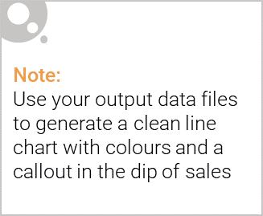
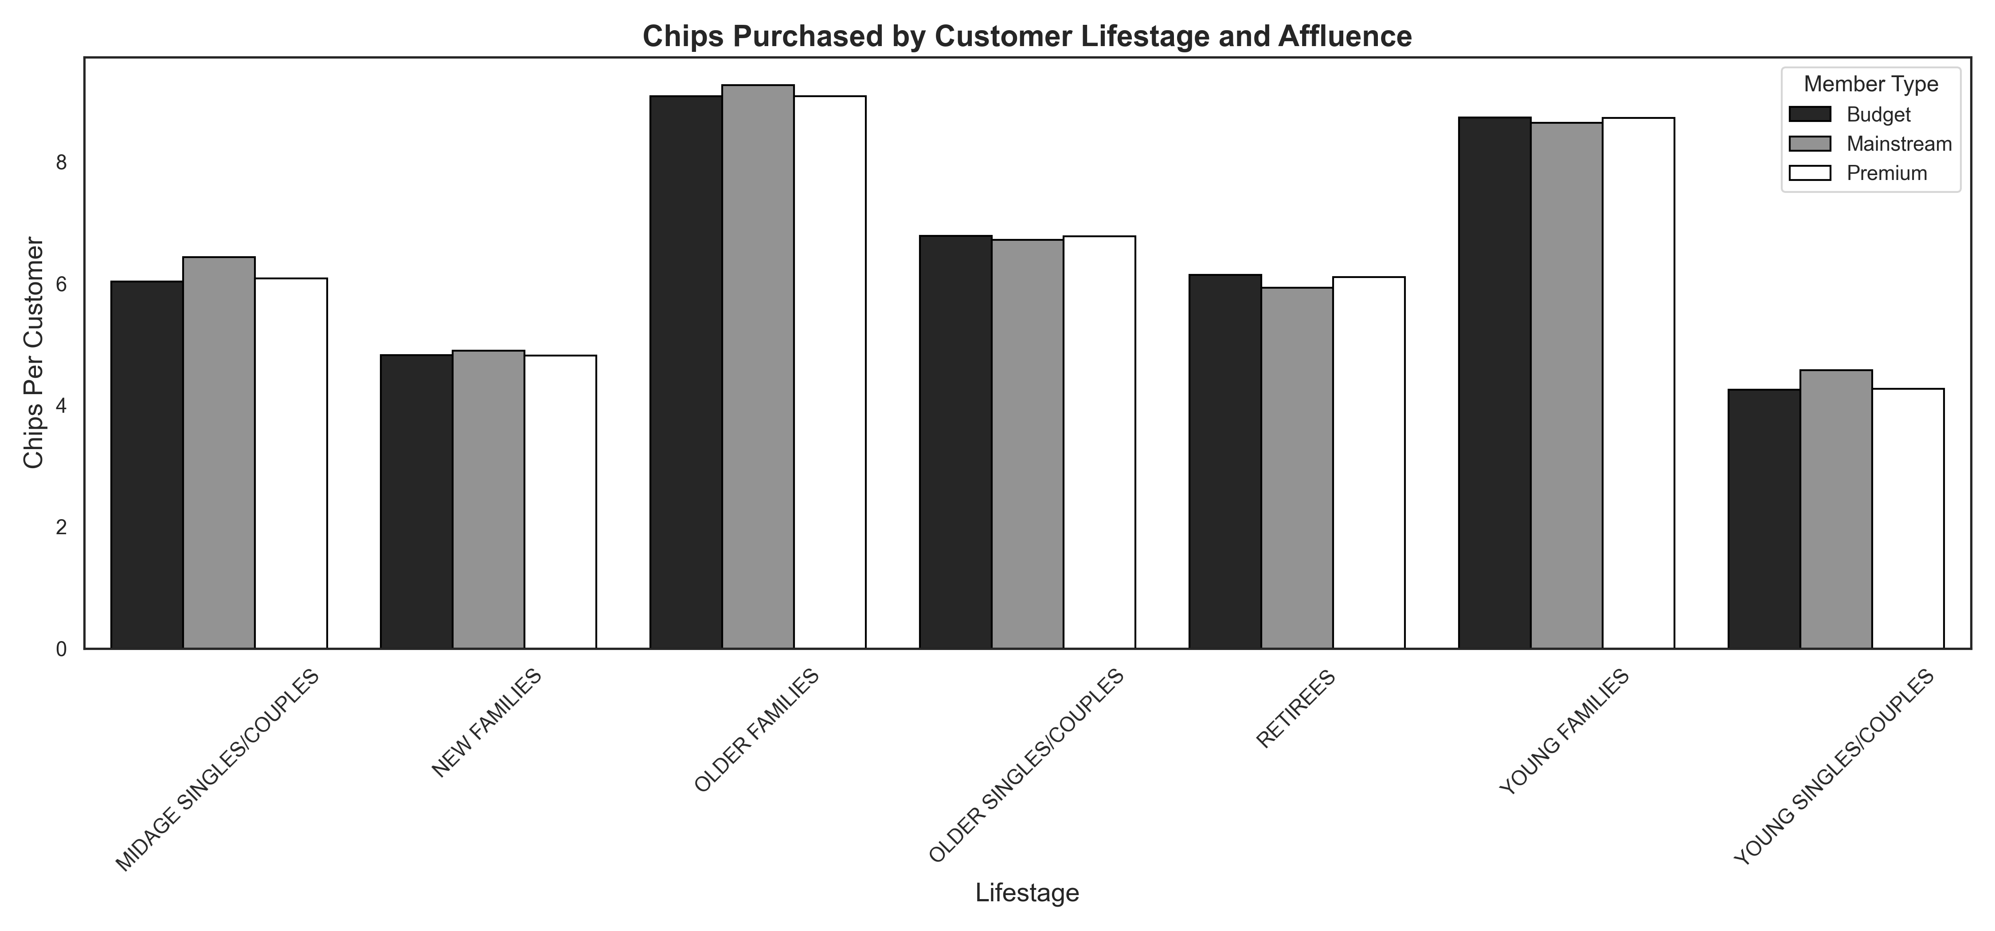
Older and young families purchase the most chips, unaffected by affluence.

Slide 6

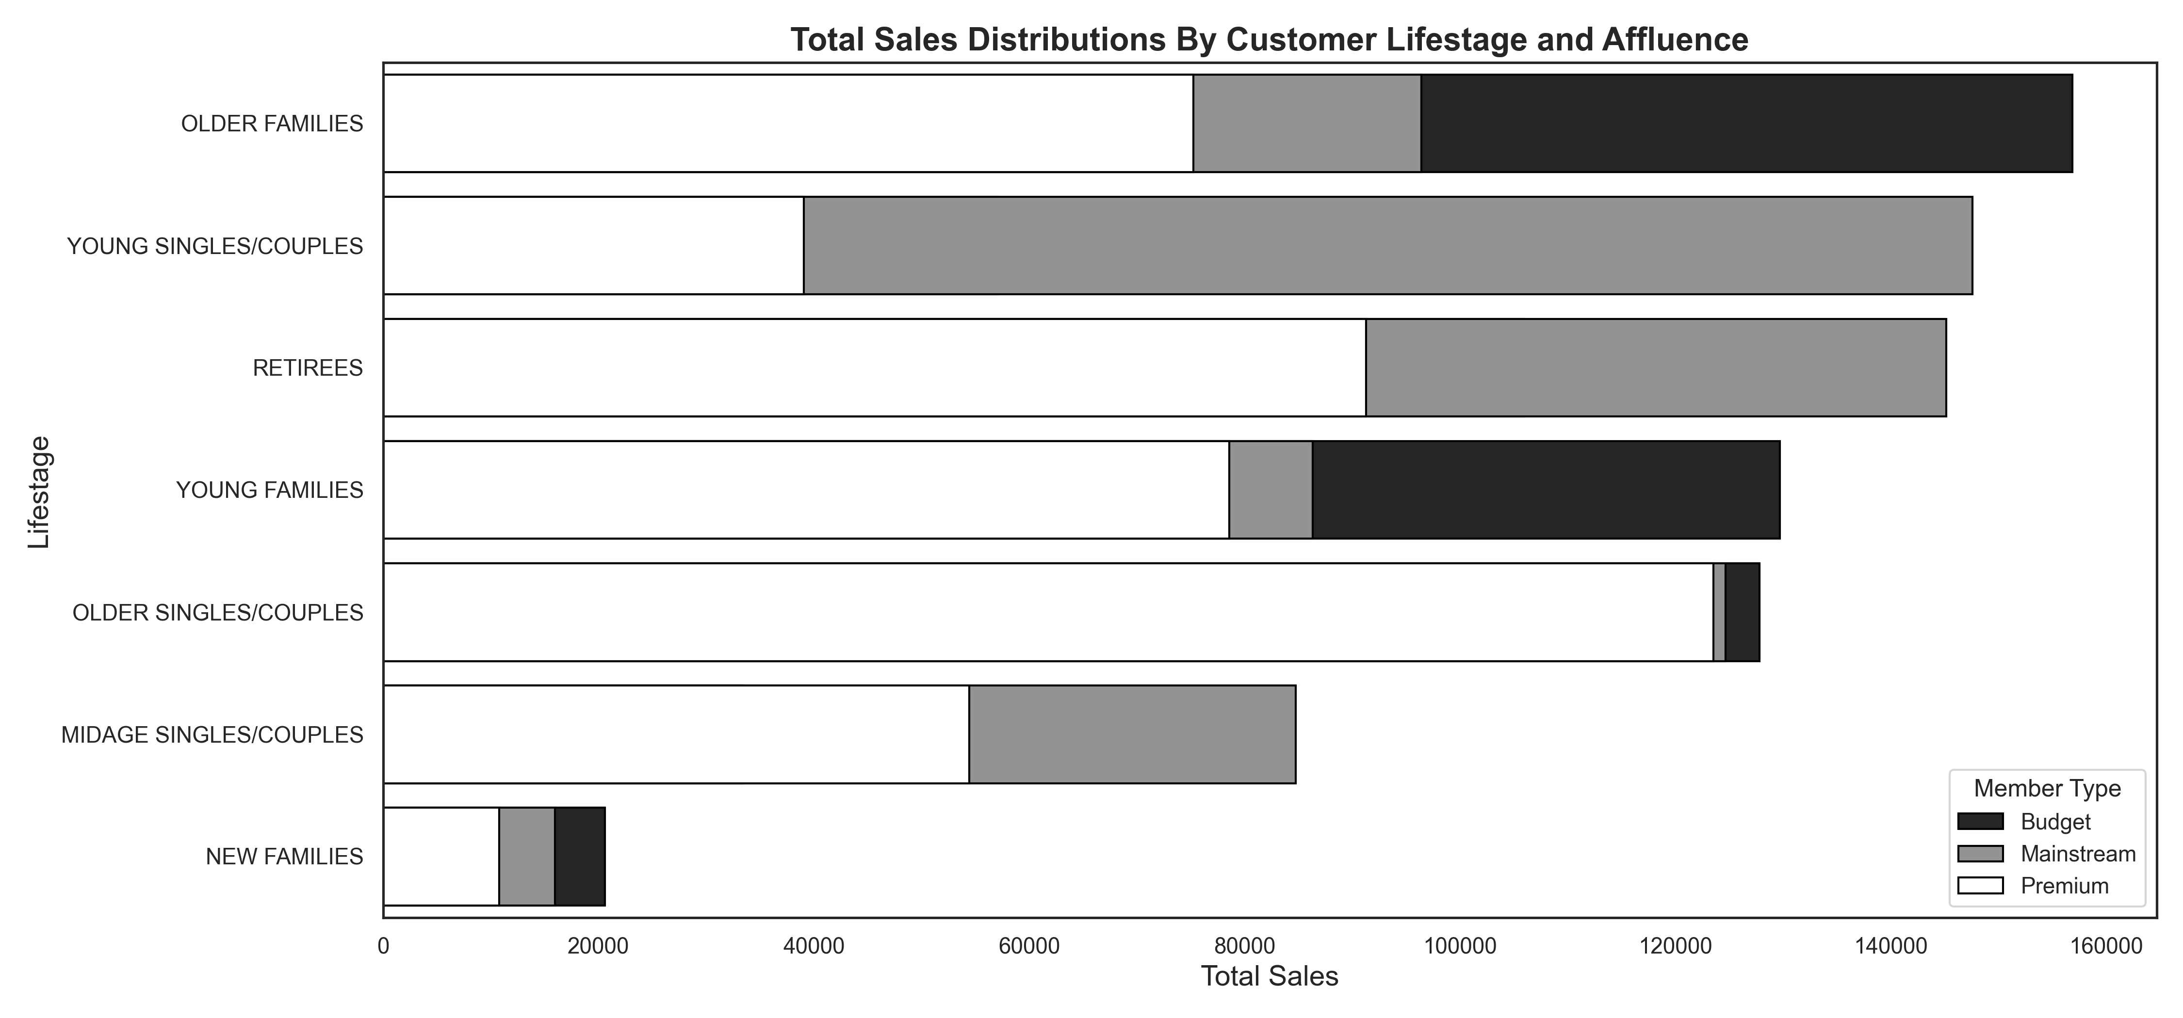
Sales are driven primarily by budget older families, followed by mainstream young singles/couples.

Slide 7
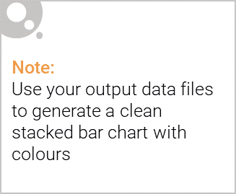
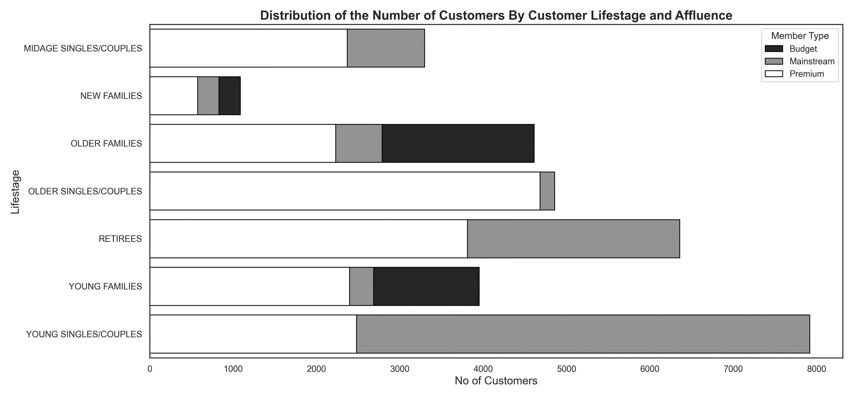
Editable (delete this)
The largest population of mainstream young singles/couples drives their sales.

Slide 8
02
Trial Store Performance

Slide 9
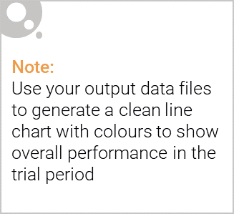
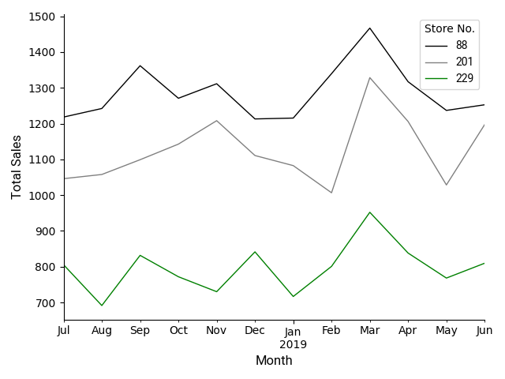
The control store is designed to reflect the performance of the trial store, not the average of other stores (e.g., stores 88 and 201).

Slide 10
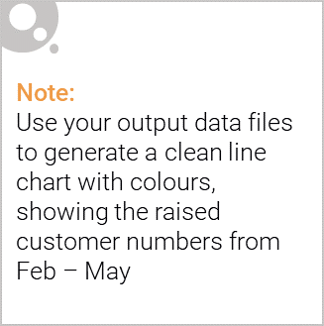
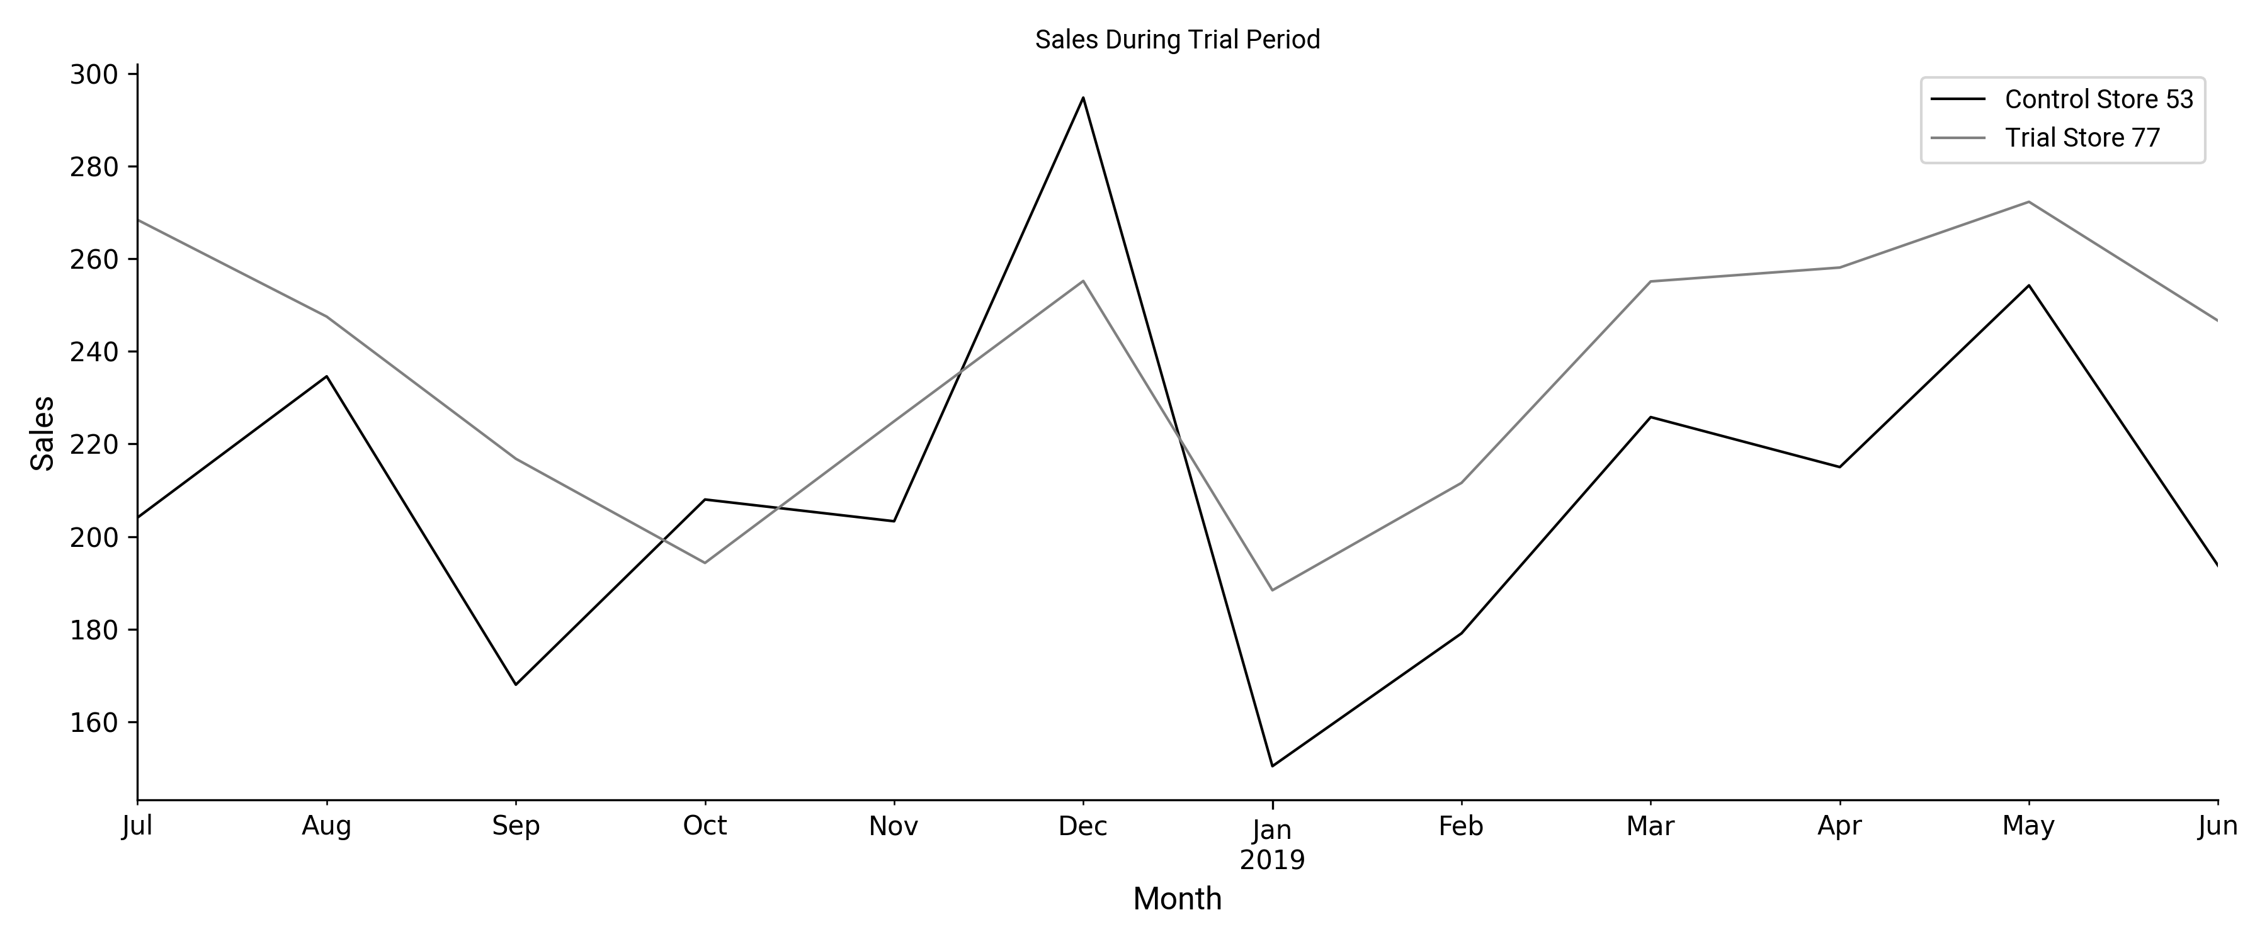
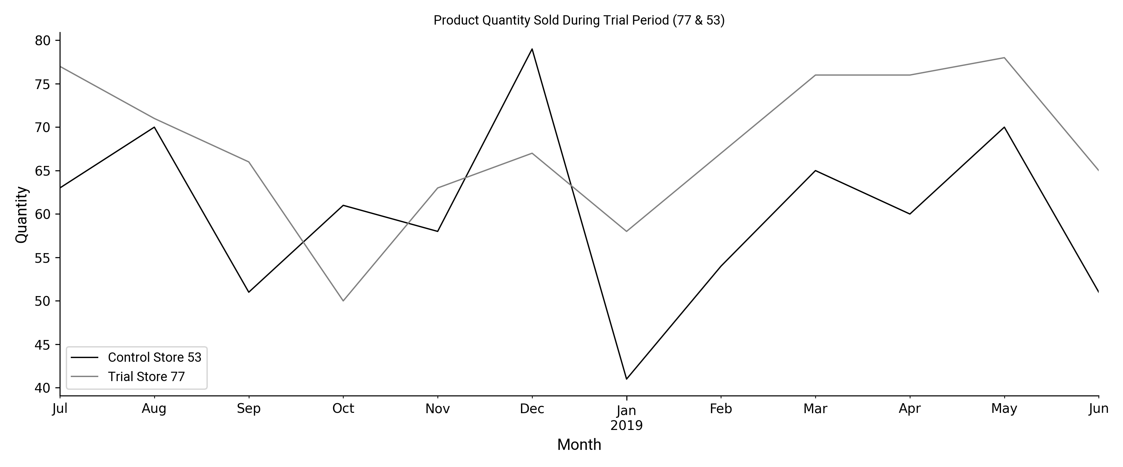
Trial Store 77 & Control Store 53: The trial was a success, with a greater increase in customer numbers than in sales.

Slide 11
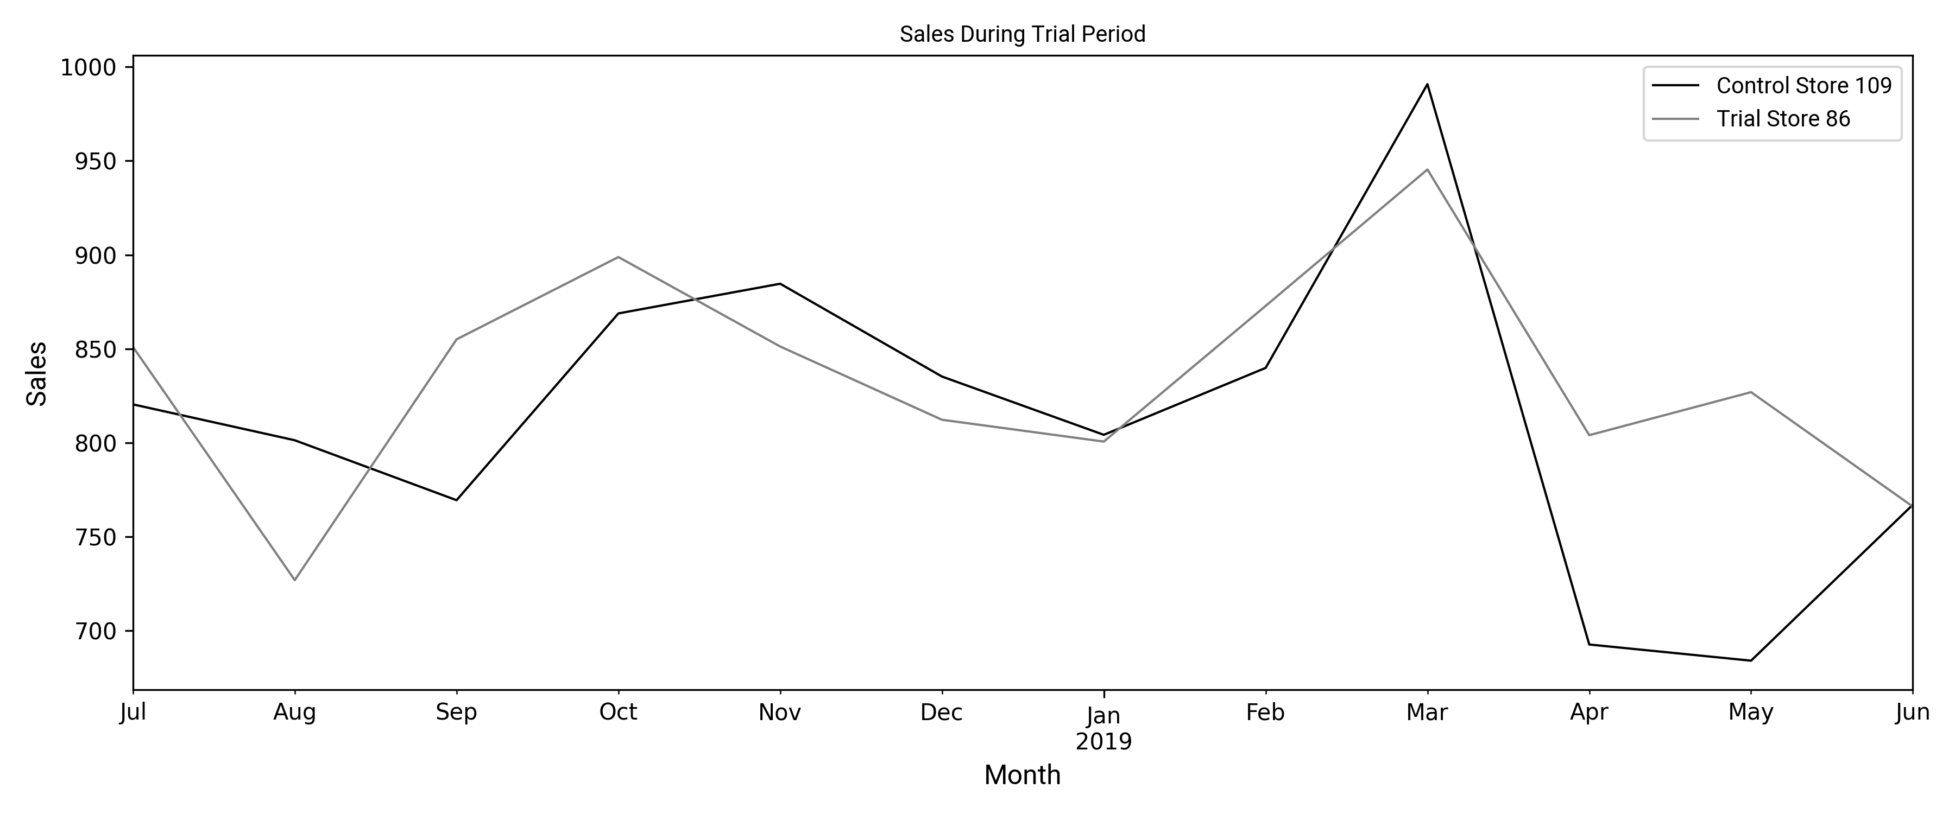
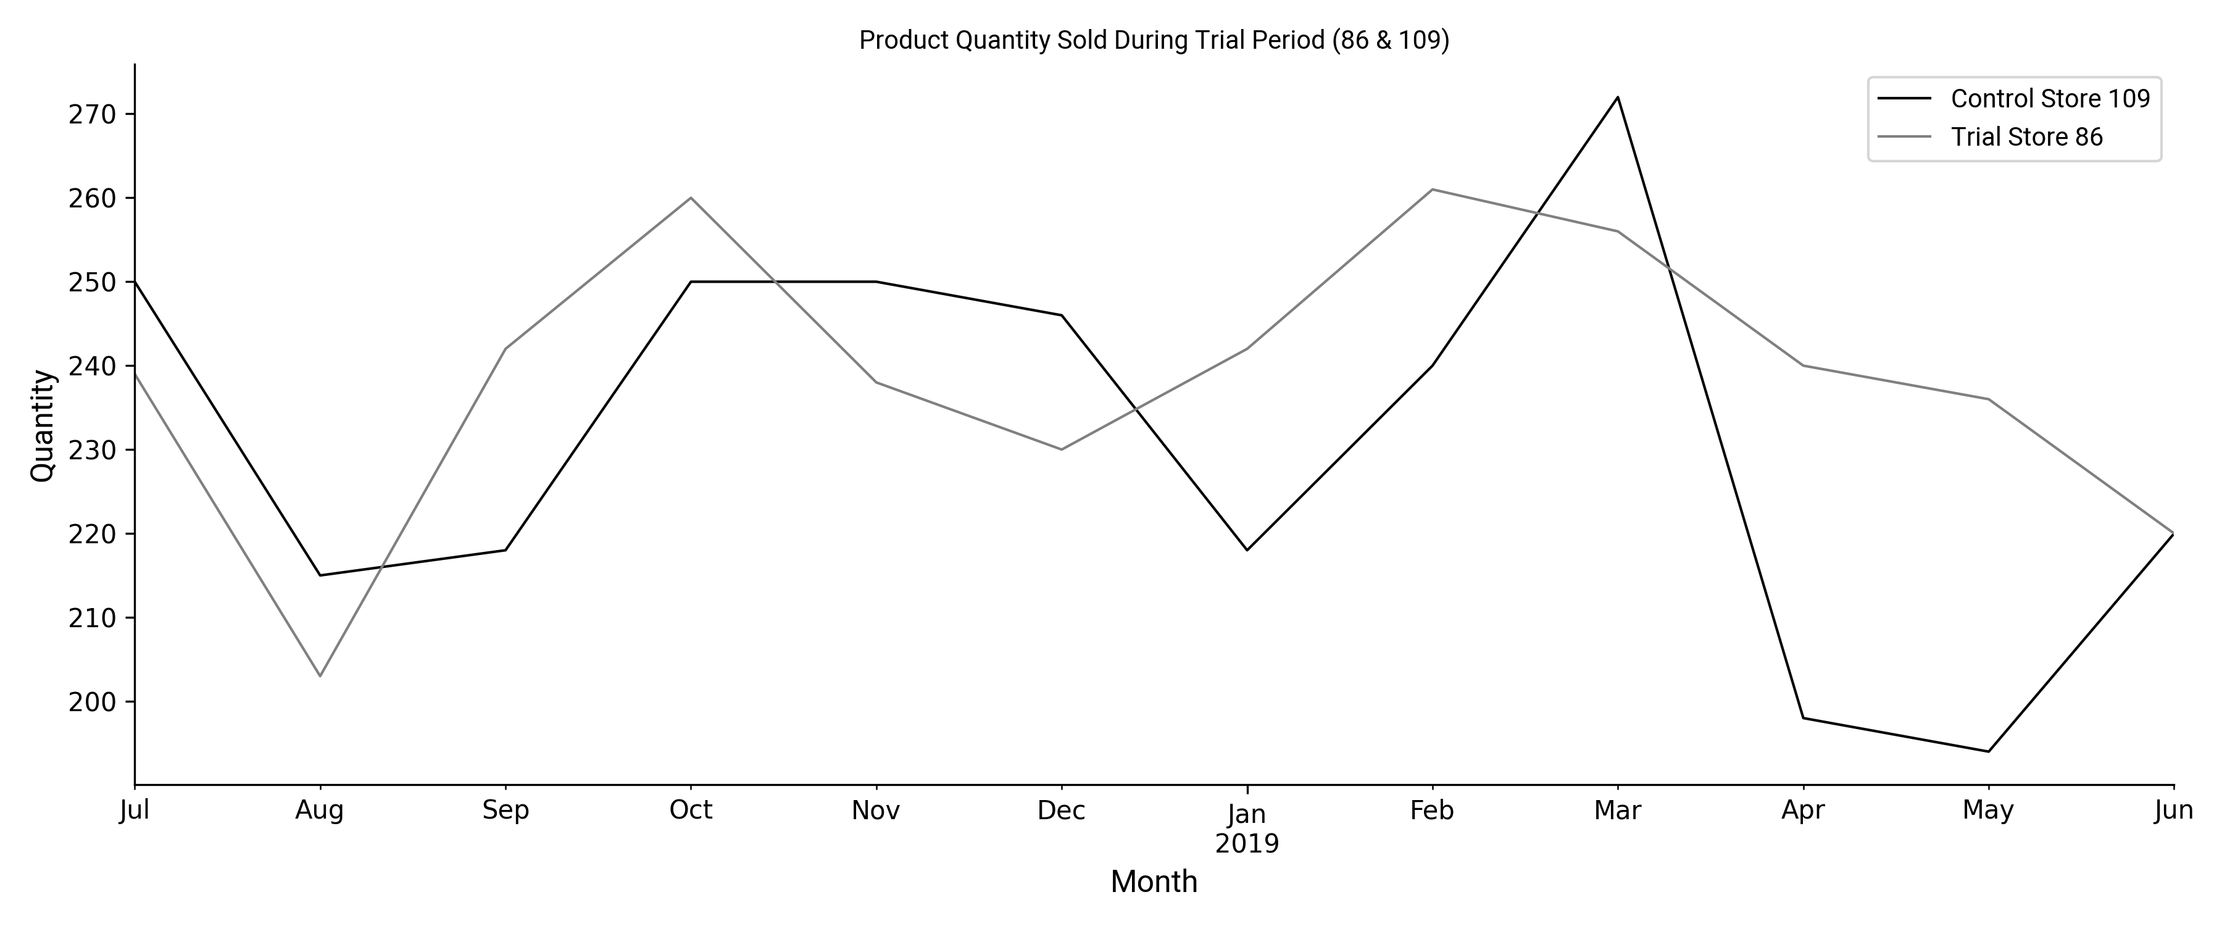
Trial Store 86 & Control Store 109: No significant difference in performance was observed.

Slide 12
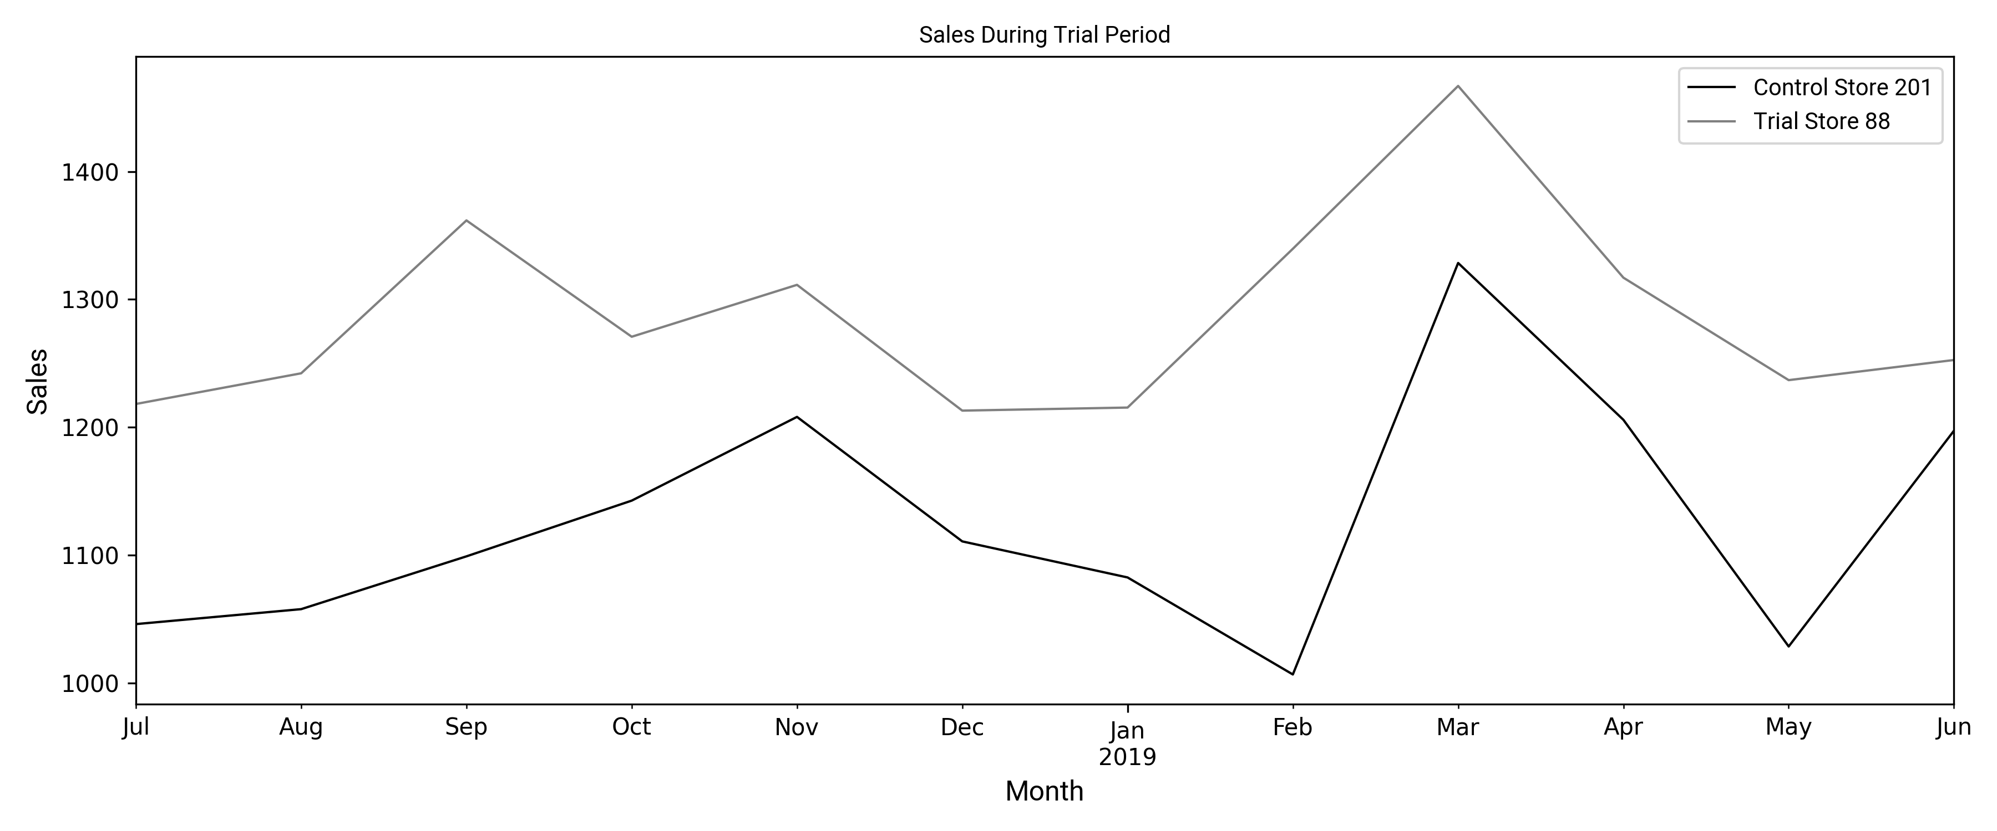
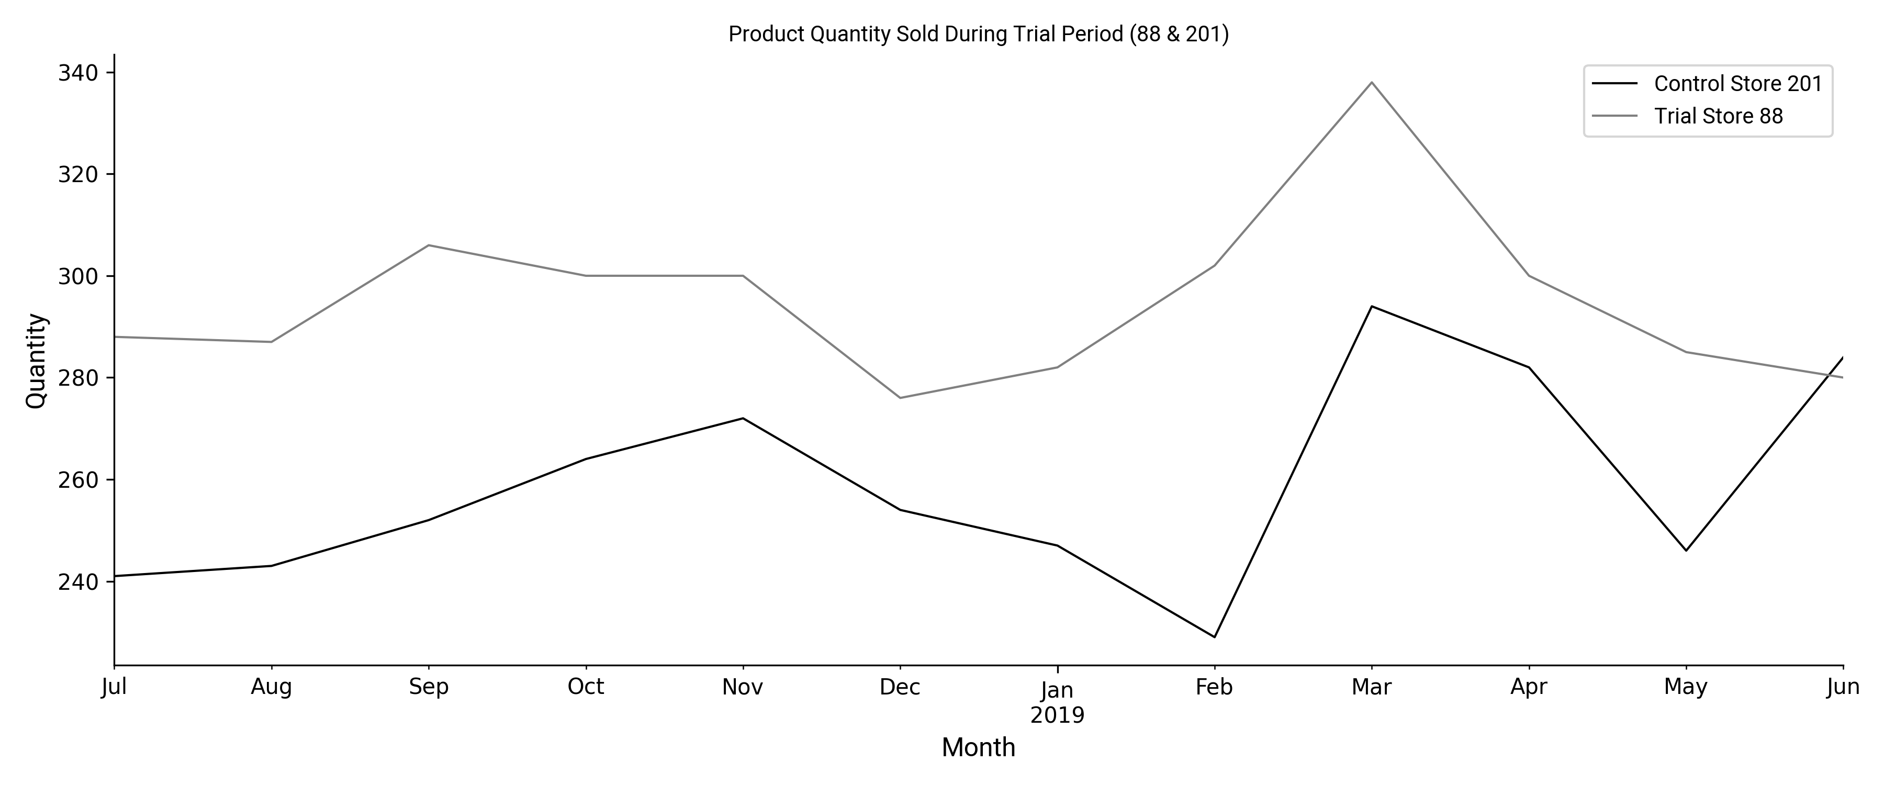
Trial Store 88 & Control Store 201: The trial was a success, with increases in sales and customer numbers.

